Slide 1
Installing Geopandas on Windows When “conda install geopandas” Doesn’t Work

Slide 2
First Install Your Dependencies
Via Wheel:
GDAL
Fiona
Via Pip:
pyproj
rtree
shapely
This combo doesn’t seem to work:
GDAL-3.3.2
Fiona-1.8.20
Use this combination:
GDAL-3.2.3
Fiona‑1.8.19
2022.01.18

Slide 3
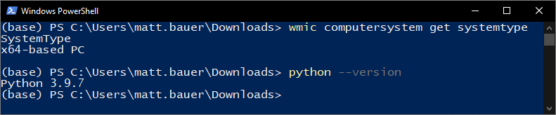
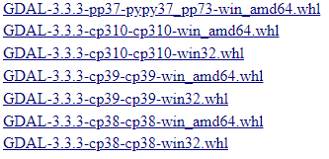
Installing Via Wheel
Get your system type. “wmic computersystem get systemtype”
Get your python version. “python --version”
Find the wheel you need from here.
Download that wheel.
Open a command prompt in that folder where you downloaded it.
Run “pip install your-wheel-name.whl”
So, with a 64-bit machine and Python 3.9 I want this one
“Package – Package – Python – 32 bit or .whl”
Name Version Version 64 bit PC
Do this for GDAL first and then fiona!

Slide 4
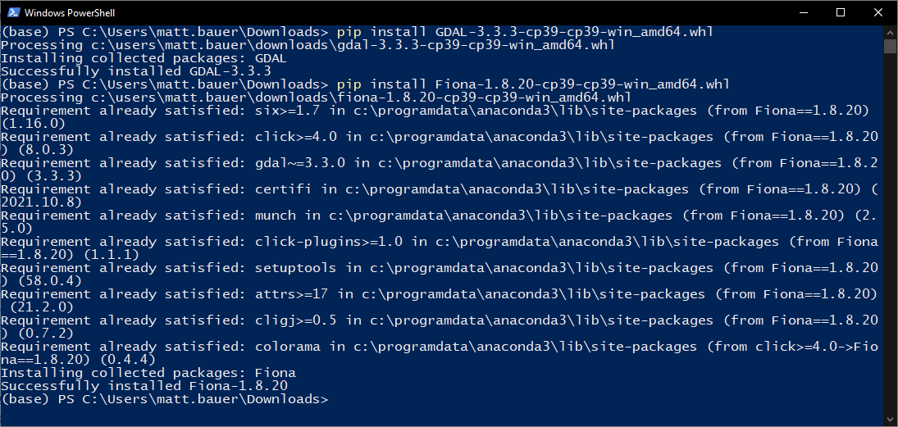

Slide 5
Pip Installation
It is usually a good idea to update pip if you haven’t recently before installing packages:
“pip install –U pip”
“pip install pyproj”
“pip install rtree”
“pip install shapely”
Then…
“pip install geopandas”

